Slide 1
HOMOEOPATHIC
DRUG
PROVINGS
Dr.Ramya S.S
Assistant Professor
Dept of Homoeopathic Pharmacy

Slide 2
“This spirit-like power to alter man’s state
of health which lies hidden in the inner
nature of medicines can in itself never
be discovered by us by a mere
effort of reason; it is only by experience of
the phenomena it displays when acting on
the state of health of man that we can
become clearly cognizant of it.”
Aphorism 20, Organon of Medicine, 6th edition

Slide 3
THE STUDY OF PROVINGS
The three basic components
of a proving are :
The Test Substance
The Proving Team
The Methodology

Slide 4
THE TEST SUBSTANCE
Drug should be proved alone, singly and in a pure and unadulterated form.
The test drug should be natural, authentic and from a reliable source.
Exact description of the pharmaceutical preparation procedure should be detailed.

Slide 5
Proving is recommended with different range of potencies, including the fifty millesimal scale potencies.
Toxicological action should be studied. The fatal dose should
also be determined.

Slide 6
DETERMINATION OF DOSAGE
Any drug that in its natural state hardly
affects the vital force will develop a
proving only in high potency.
Any drug that in its natural state disturbs the
vital energy to functional manifestations only may be proven in a crude form.
Any drug that in its natural state disturbs the
vital energy to destructive manifestations should be proved only in a potentised form.

Slide 7
THE PROVING TEAM
Project Director / Master Prover
Advisor / Expert
Proving Supervisors /
Panel of Investigators
Provers

Slide 8
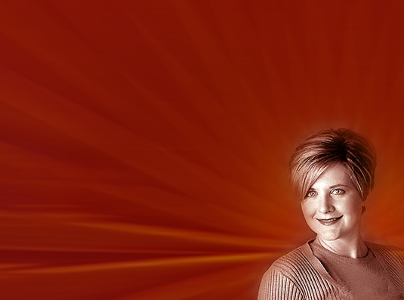
SELECTION OF PROVERS
The prover should be reasonably healthy.
Age - between 18-45 years of age.
Drug must be proved on both
males & females and of various constitutions.
Hysterical and stoic
personalities should
be avoided.

Slide 9
Women during pregnancy or during breast-feeding are to be excluded
from provings.
Provers should not be paid for the provings.
At least 20-30 provers should be employed, including 25-30%
controls that receive placebo.

Slide 10
METHODOLOGY OF PROVING
Proving requires a meticulous planning
and study before and after the proving.
Hence the proving experiment is best
studied under three different protocols.
1. The Pre-proving Protocol
2. The Proving
3. Post Proving Protocol

Slide 11
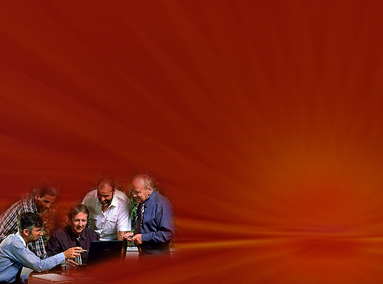
THE PRE-PROVING PROTOCOL
Project Director decides and studies the test drug covering areas of pharmacognosy, standardization, pharmacology and toxicology. An antidote to the test drug, if any, is confirmed.
He selects the panel of investigators or
supervisors and instructs them about the
ethics and conduct of proving.
He is responsible for
the primary coding
of the remedy.

Slide 12
Along with the supervisors and the experts,
he screens the possible provers. The
Supervisors prepare the Initial Medical
Report Proforma.
The provers are briefed about the importance, ethics and details of the proving programme.
Consent should be obtained in writing
from prover.
The investigating team should discontinue
the provings if in their judgement, if any, if
continued, be harmful to the subject.

Slide 13
THE PROVING
Multicentric trials :
Studies are to be conducted at least
at three different centres before
releasing the data for professional use :
Mountains
Plains
Seashore

Slide 14
Orientation meeting :
Orientation meetings are arranged at the commencement of the proving. The aim of the orientation meeting is to explain the importance and conduct of the proving process in detail.
The daybooks are also provided to the provers for the recording of the proving.

Slide 15
NATURE OF TRIALS
Randomized
Double Blind
Double Controlled Provings
Croos Over Studies

Slide 16
RECORDING OF PROVING
Initial Medical Report Proforma
Prover’s Daybook / Logbook
Response Monitoring Proforma

Slide 17
RECORDING OF SYMPTOMS
How to note :
Provers and supervisors should refrain from discussing symptoms or experiences.
Recording should be as frequently as possible.
Each day is started on a new page with the date and which day of the proving it is, noted at the top of each page. The day of the first dose is day one.

Slide 18
The prover should note in detail the symptoms in one’s own language,
in first person.
Symptoms have to be reviewed, investigated, clarified and recorded
in detail by supervisor.

Slide 19
What to note :
Prover notes down any symptoms that arise, whether they are old or new and at what time of the day or night they occurred.
The prover must note down distinctly the sensation, sufferings, accidents and changes of health he experiences at the time of their occurrence, mentioning the time after the ingestion of the drug.

Slide 20
This information should be recorded on the right hand page of the daybook.
The left hand page is devoted to recording the details and circumstances of the proving experiences in one’s own words.

Slide 21
CRITERIA FOR INCLUDING SYMPTOMS
New symptoms, unfamiliar to the prover.
Usual or current symptoms that are intensified.
Current symptoms modified or altered.
Old symptoms that have not occurred for at least one year.

Slide 22
Present symptoms that have disappeared during the proving.
If a symptom is in doubt, it is
included in brackets.
If another prover experienced the same symptom it could be valid.
If not, it is excluded.

Slide 23
PRECAUTIONS TO BE TAKEN BY PROVER DURING DRUG PROVING
Avoid all substances with medicinal
properties.
Provers must be at least 3 months
clear of any previous treatment or of
a homeopathic remedy.
There should be a strict regulation of
diet when the drug is being proved.

Slide 24
Diet during proving should be purely
nutritious and of simple character.
Overexertion of mind and body should
be avoided.
Provers should stick to their normal
habits and way of life.

Slide 25
POST PROVING PROTOCOL
The proving records are thoroughly
screened and analysed.
The symptoms collected from all the
provers is to be sifted in such a manner
that all the relevant data collected is not
lost, but shall have a proper flow of thought,
so that the mental, physical and functional
state of the drug is understood.
Adequate data indexing is done as per the
pattern of Kent's repertory so that the data
is rendered clinically useful.

Slide 26
ANALYSIS OF PROVING RECORDS
Extracting, collating, analysing, theming
Into Materia Medica and repertorising are
the most laborious, painstaking and time-
consuming stages of carrying out a proving.
A well-balanced group for this task
should be of experienced homeopaths,
well acquainted with different repertories
and repertory language.
A good working knowledge of the native
language of the provers is also required.

Slide 27
EXTRACTION
This involves converting daybooks into
format of the Materia Medica and the
extracting of valid symptoms.
The observations and experiences of all
the provers have to be analyzed, compared
with their Initial Medical Report Proforma,
and finally comparision of the control, test
and crossover groups is done.

Slide 28
COLLATION
The aim of collation stage is to
synthesise the proving from all separate
accounts of each prover as if it belonged
to and evolved in a single person.
All the prover's separate sheets are put
together. Symptoms with a common
denominator are grouped together under
each section.

Slide 29
REPERTORISATION
The aim of repertorising stage is to
accurately and truthfully interpret the
proving information into repertory
language.
Each symptom is accurately analysed
and translated into a rubric.
Certain symptoms may require creating
new rubrics. The remedy is then
considered for addition into the rubrics.

Slide 30
THEMING THE SYMPTOMS
These symptoms are studied for its peculiar
pattern that emerges out of the proving.
The Generalities at the physical level, the
constitutional affinity, the characteristic
peculiar state of mind and disposition is
then studied.
This theming of the proving is the practical
outcome of the painstaking effort of the
entire project.

Slide 31
PUBLICATION
The final publication, in book form or in a
journal or electronic form should include
Materia Medica, repertorization, information
about the substance and its toxicology.
This should give the complete view of the
remedy picture and a summary of the
proving, with discussion and conclusions.
Data indexing should be as per the scheme
followed in Kent’s repertory.

Slide 32
CRITERIA FOR THOROUGH PROVING
Drug must be proved on suitable persons of both sexes and of various constitutions.
Almost always only the same symptoms as had already been observed by others are exhibited during reproving.

Slide 33
The symptoms are most carefully recorded with regard to their specific sensations, locations, modalities with their concomitant factors, so that a complete individual picture of the
drug is established.
Clinically verified.

